Slide 1
Assess the overall satisfaction and identify areas of improvement in NIBM campus
STAT CW
LHM FERNANDO
KAHDSE222F-020

Slide 2
agenda
Project objective Method of sample selection
Expected scope to be covered and scope exclusion Method of data collection
Statistical tools to be used in the analysis
How to digitalize for a larger population
Innovations and key selling points

Slide 3
Project objective
The objective of this project is to assess the overall satisfaction and identify areas of improvement in NIBM campus by gathering feedback from current students, past students, and other individuals associated with the campus. By analyzing the data, i aim to understand perceptions, identify strengths and weaknesses, and make informed recommendations for enhancing the campus experience.
STAT CW
KAHDSE222F-020
LHM fernando

Slide 4
Method of sample selection
combination of convenience sampling and snowball sampling methods to select participants. Start by surveying current students and then ask them to refer past students and other individuals connected to the campus.

Slide 5
Expected scope to be covered and scope exclusion
The project will focus on gathering feedback related to the campus experience, including academics, facilities, extracurricular activities, support services, and overall satisfaction. Scope exclusion may include factors unrelated to the campus environment, such as personal circumstances or external factors.
STAT CW
KAHDSE222F-020
LHM fernando

Slide 6
Method of data collection
Utilize a combination of survey/questionnaire and interviews to collect data.
Design a comprehensive survey/questionnaire that covers various aspects of the campus experience and encourages participants to provide detailed feedback.
Conduct interviews with a subset of participants to gather more in-depth insights and perspectives.
STAT CW
KAHDSE222F-020
LHM fernando

Slide 7
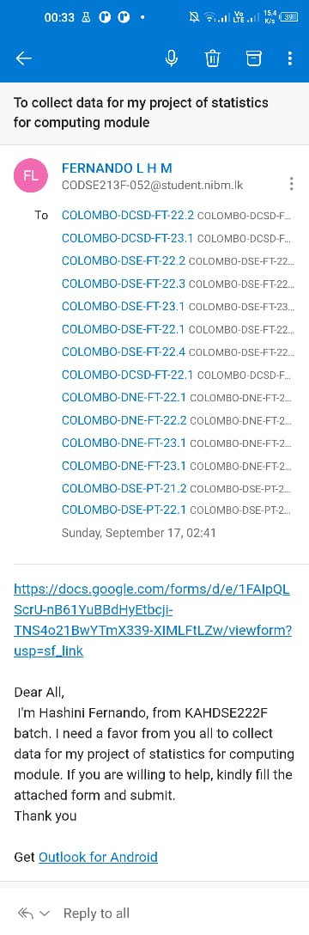
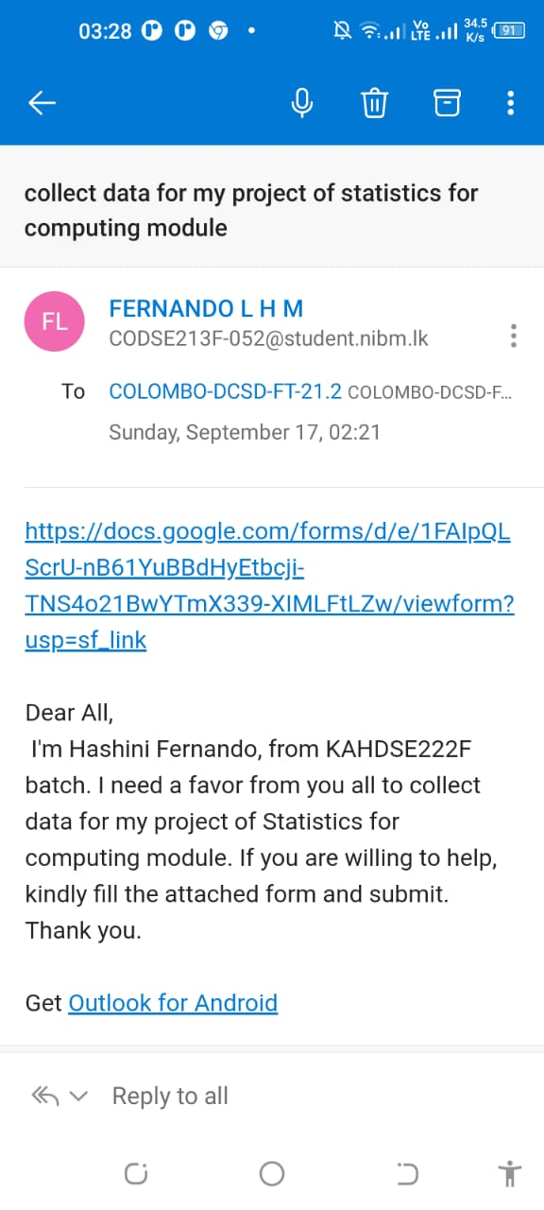
Process

Slide 8
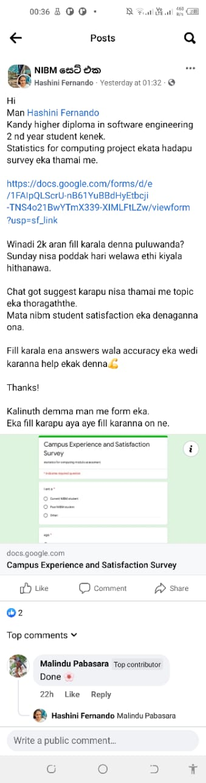
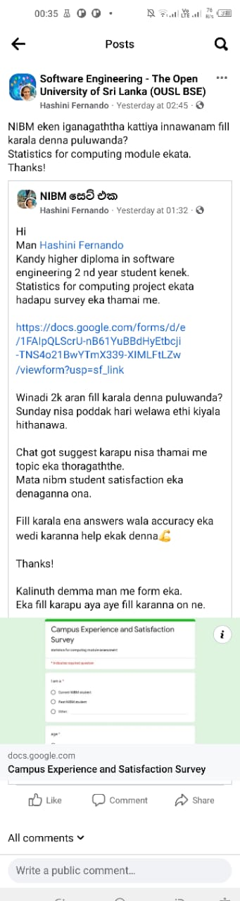
Process

Slide 9
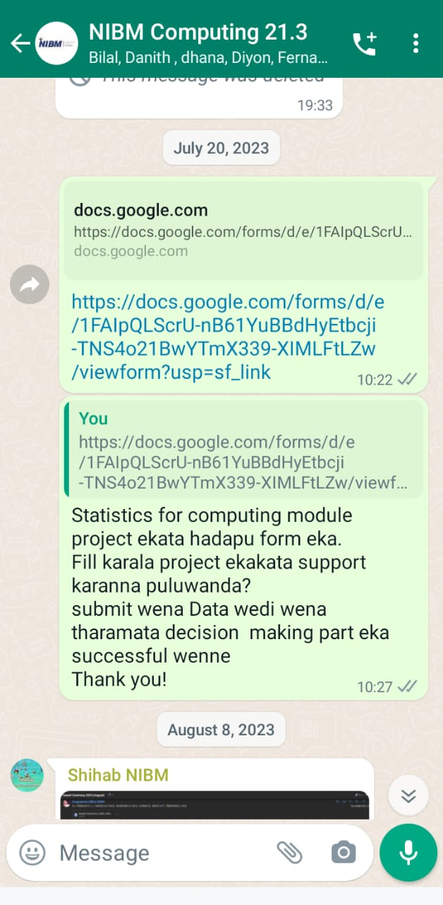
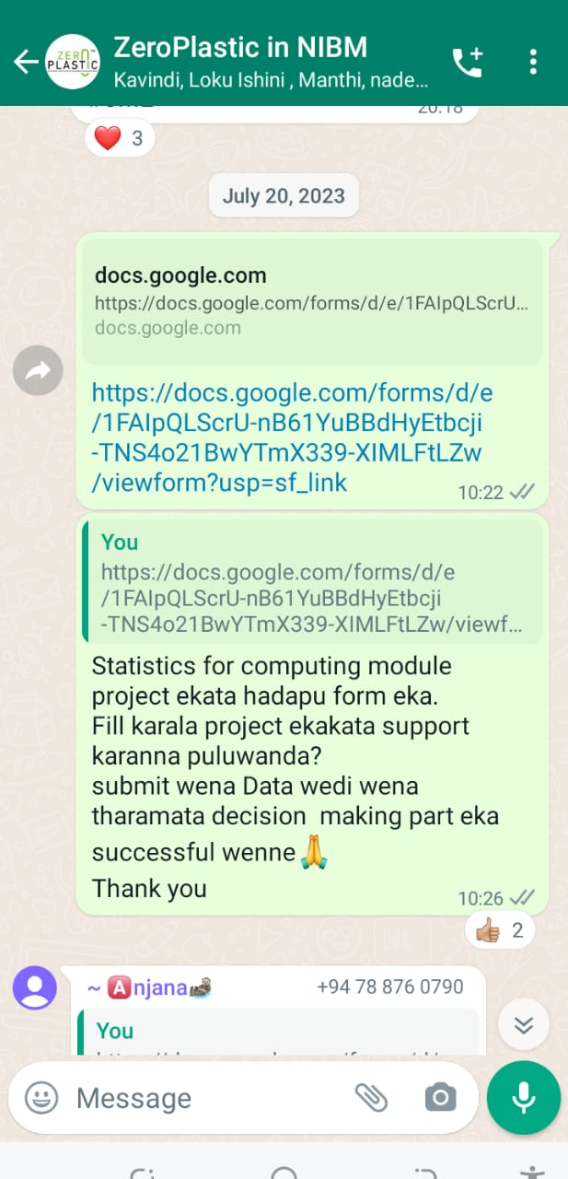
Process

Slide 10
Process
Google form
https://docs.google.com/forms/d/17qj2TmKgbHVEZxBfWQCzBqFpDzdBP8pGESMk8-BOcNs/edit?chromeless=1

Slide 11
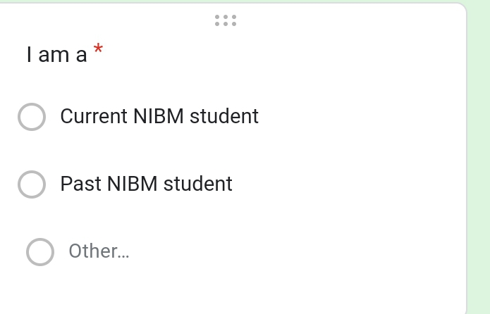
Question 1

Slide 12
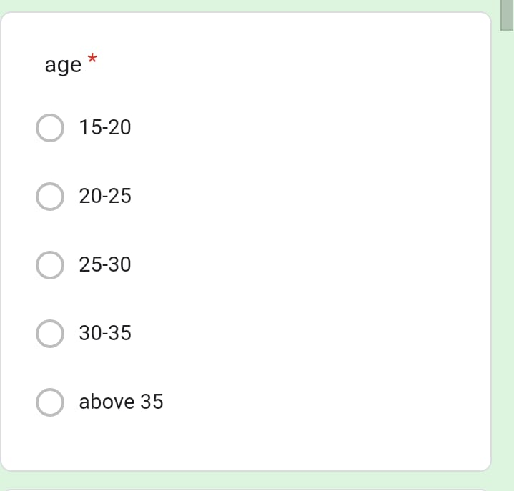
Question 2

Slide 13
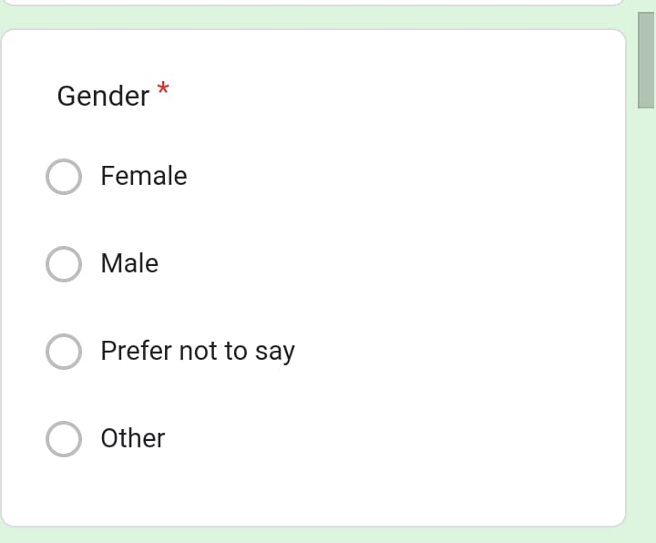
Question 3

Slide 14
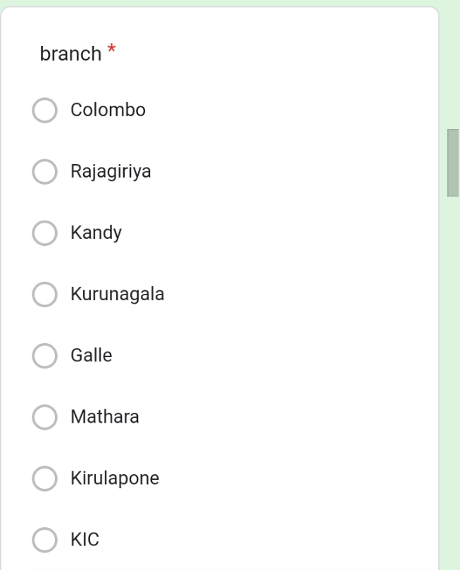
Question 4

Slide 15
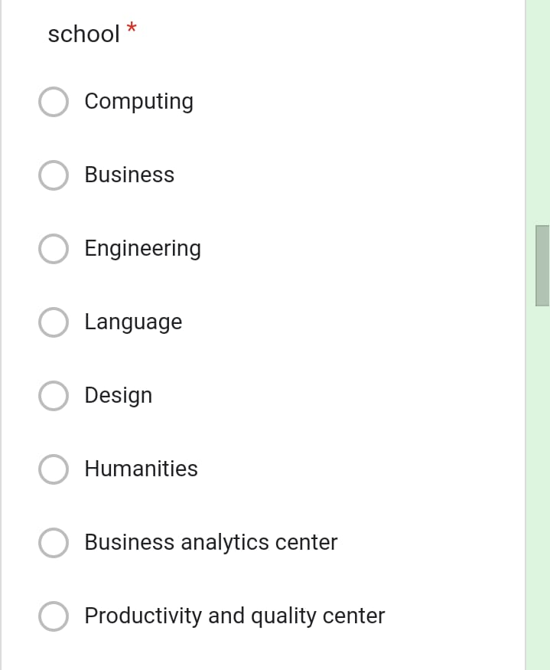
Question 5

Slide 16
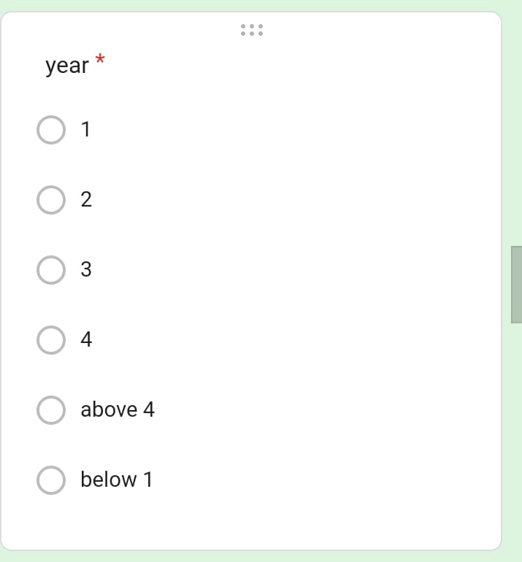
Question 6

Slide 17
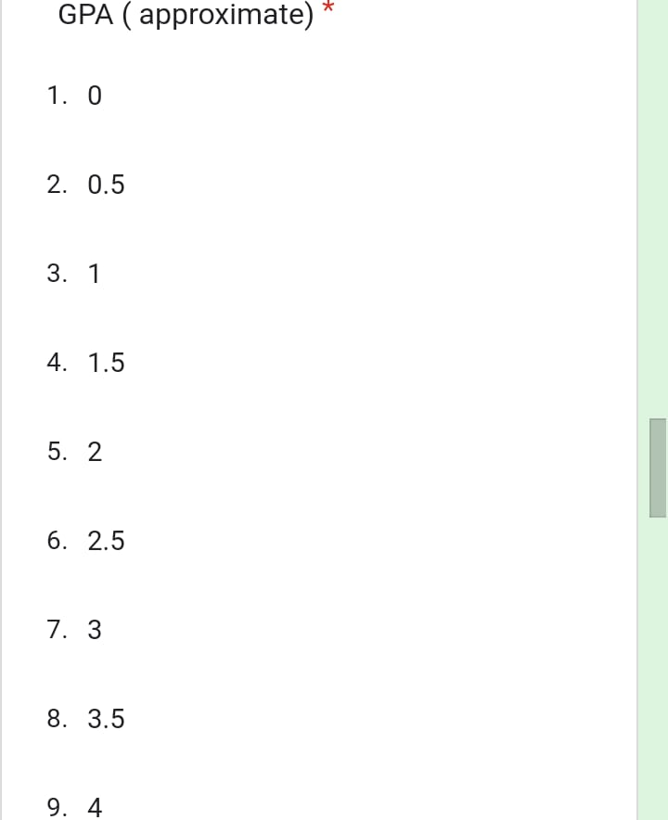
Question 7

Slide 18
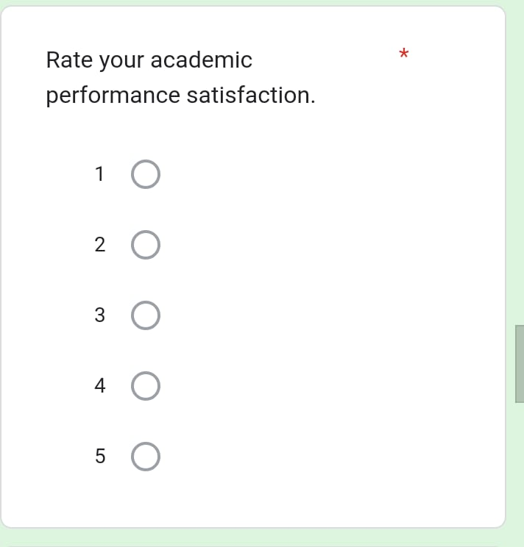
Question 8

Slide 19
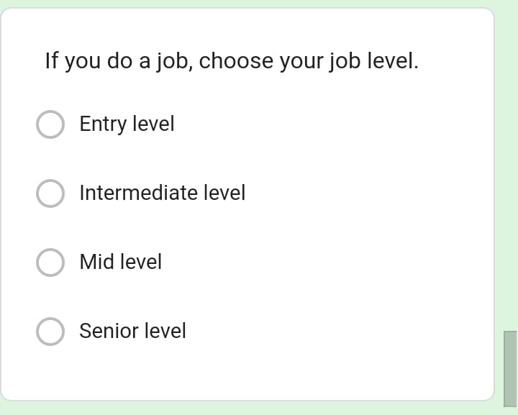
Question 9

Slide 20
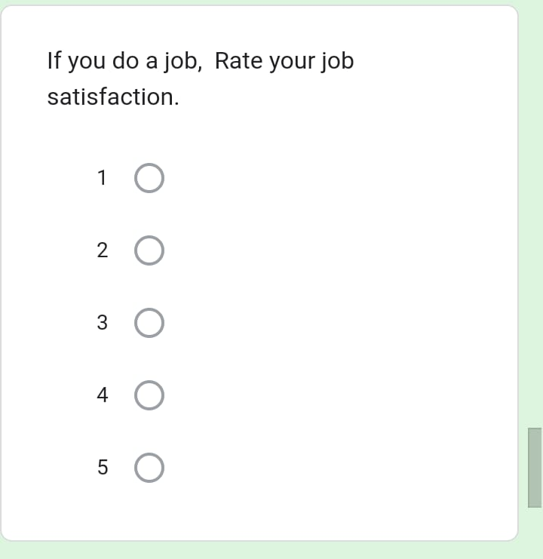
Question 10

Slide 21
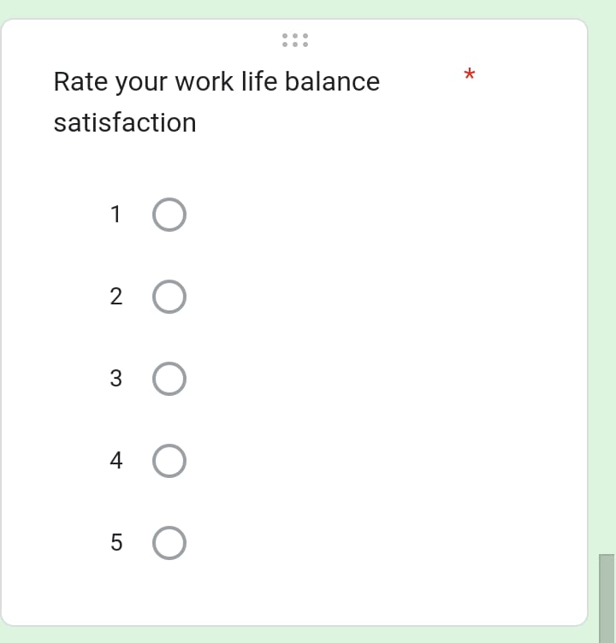
Question 11

Slide 22
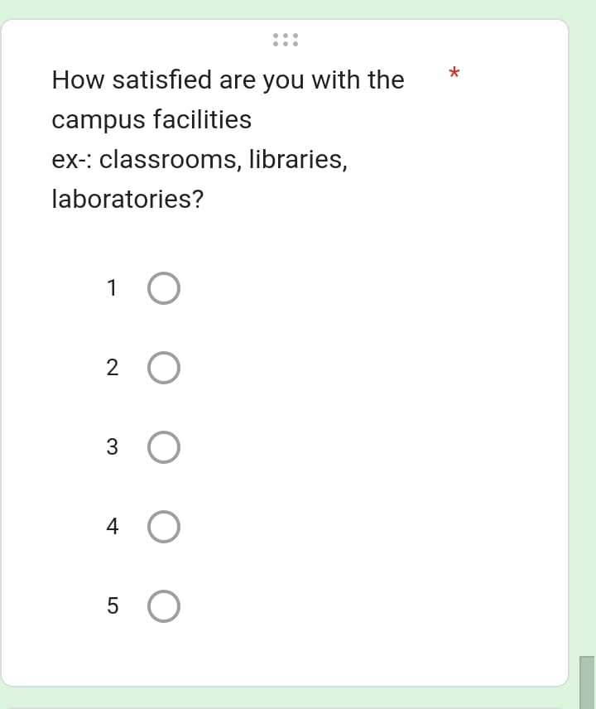
Question 12

Slide 23
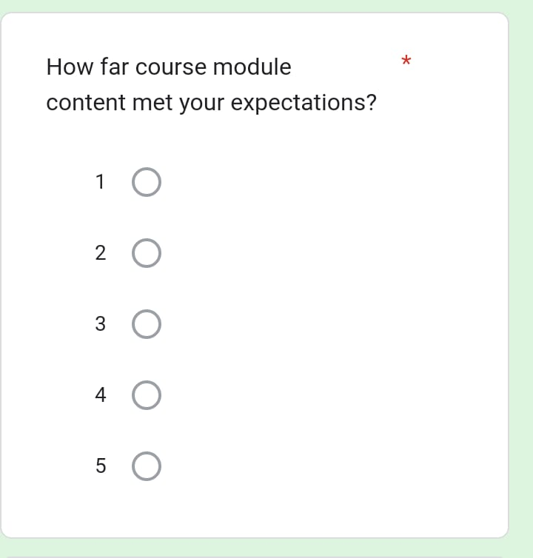
Question 13

Slide 24
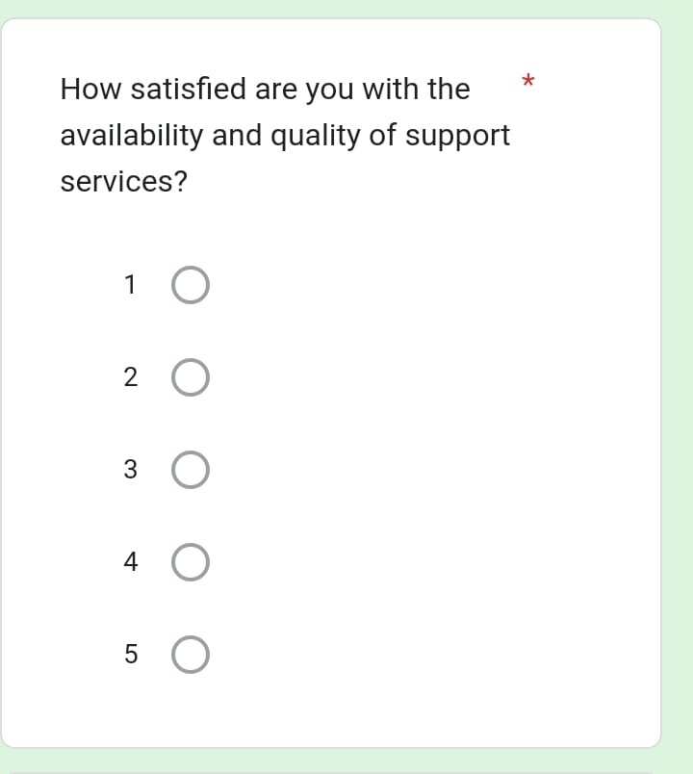
Question 14

Slide 25
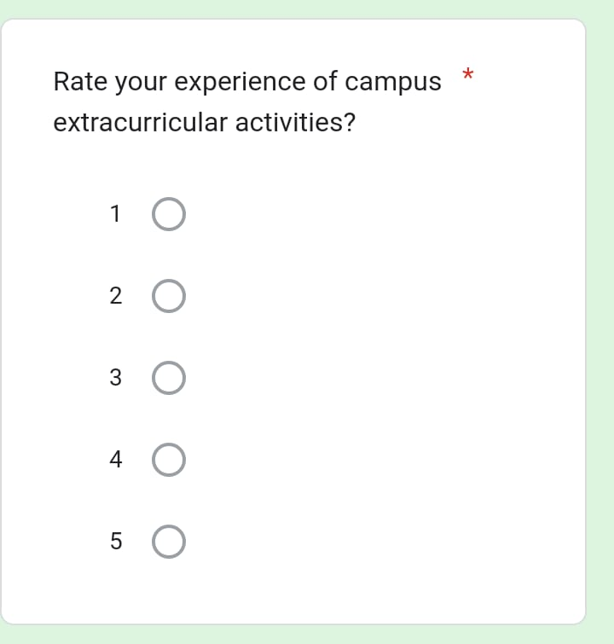
Question 15

Slide 26
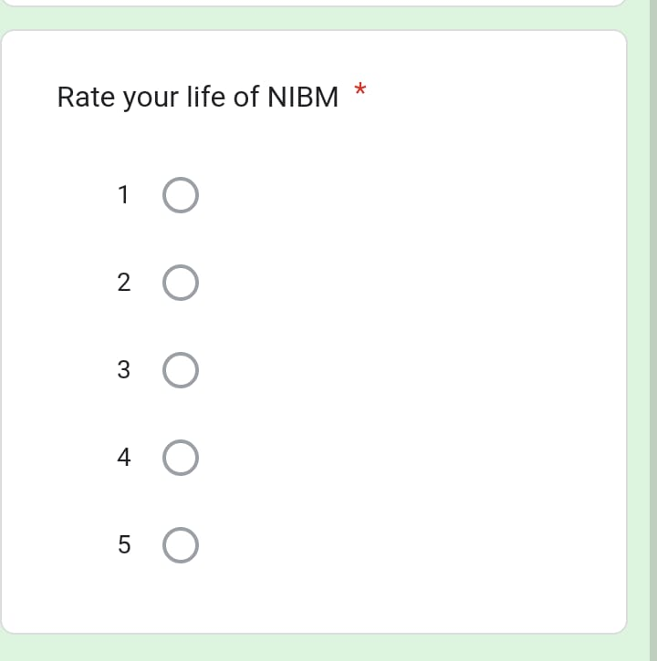
Question 16

Slide 27
Results
https://docs.google.com/spreadsheets/d/1V1qTHmjs-kuzp2kpO4ihmBdaB4nGd9zf/edit?usp=drivesdk&ouid=109612488775937028682&rtpof=true&sd=true

Slide 28
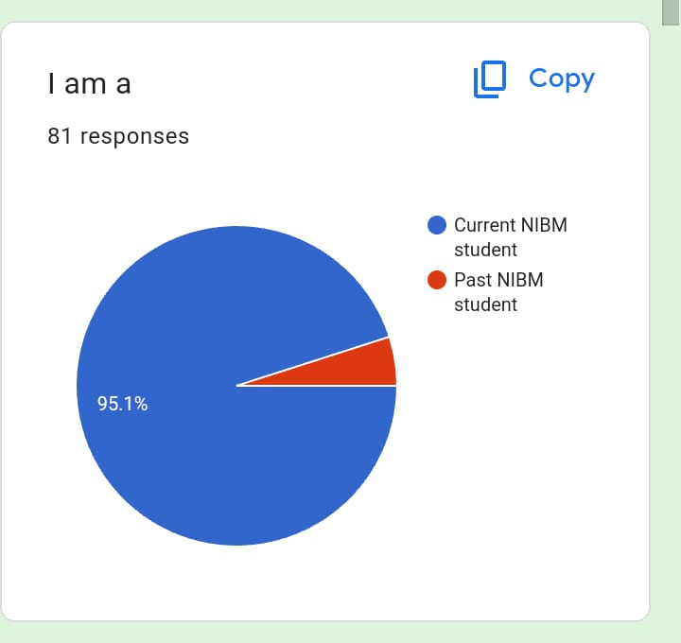
Question 1

Slide 29
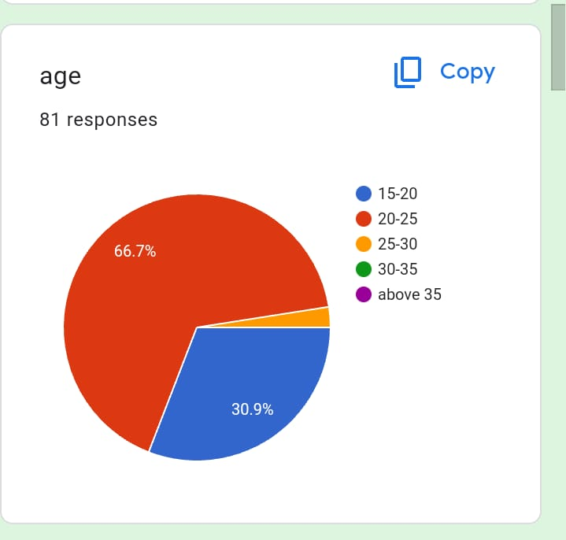
Question 2

Slide 30
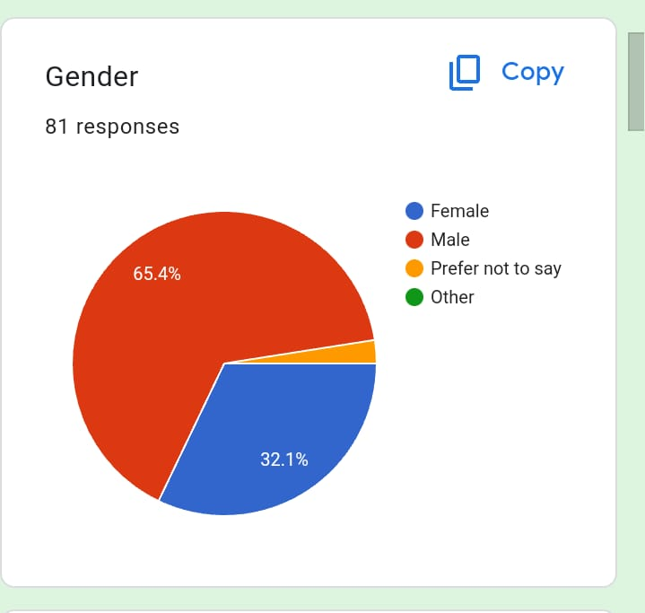
Question 3

Slide 31
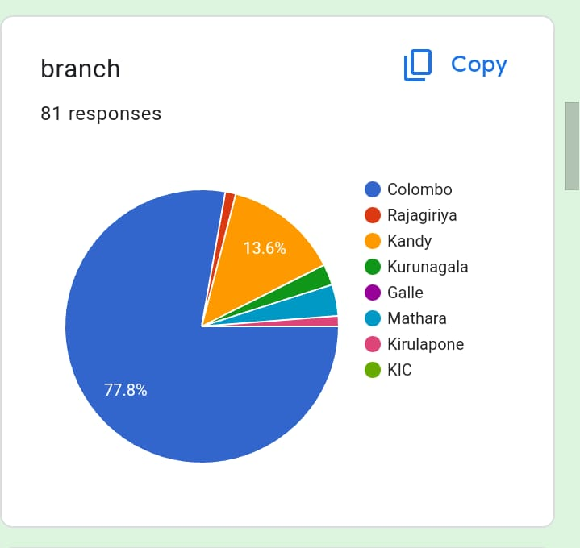
Question 4

Slide 32
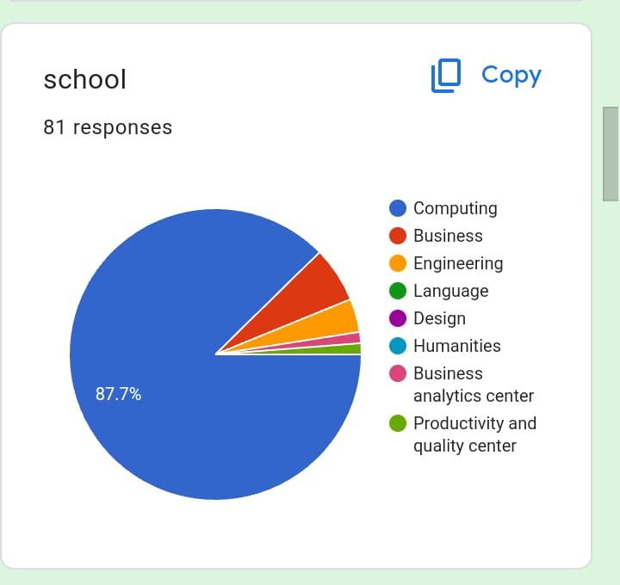
Question 5

Slide 33
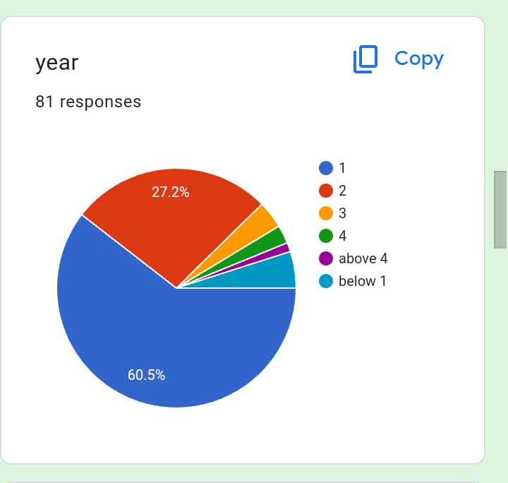
Question 6

Slide 34
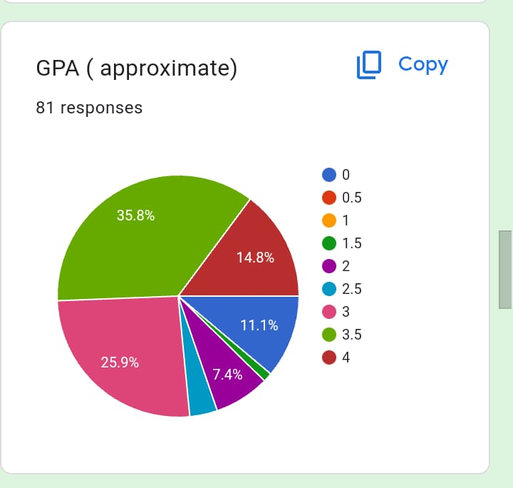
Question 7

Slide 35
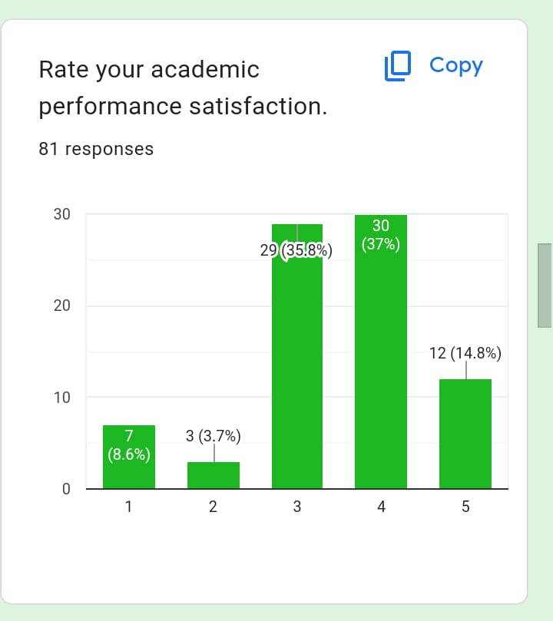
Question 8

Slide 36
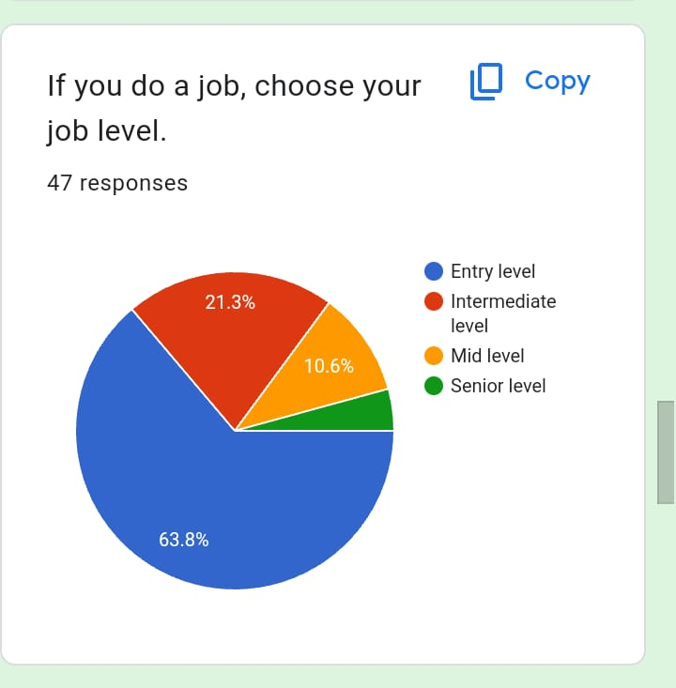
Question 9

Slide 37
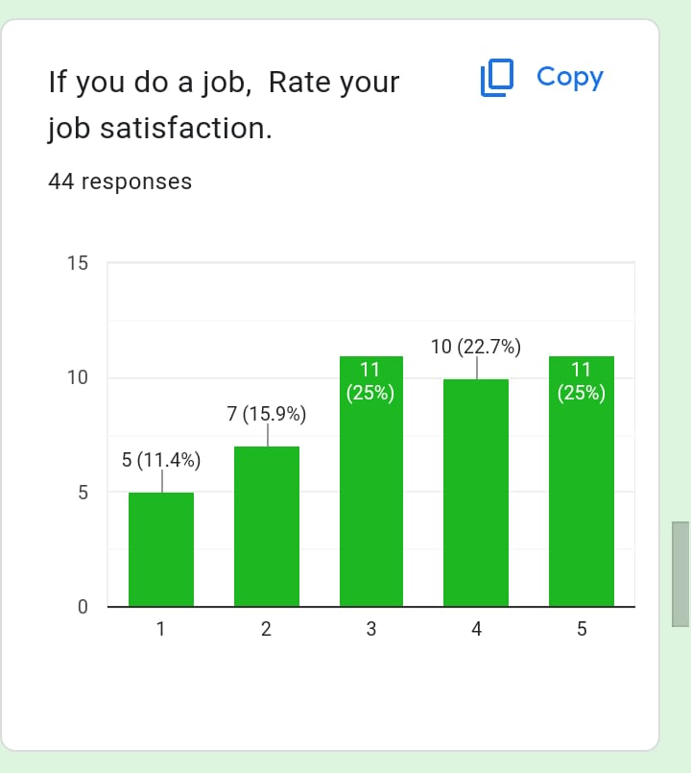
Question 10

Slide 38
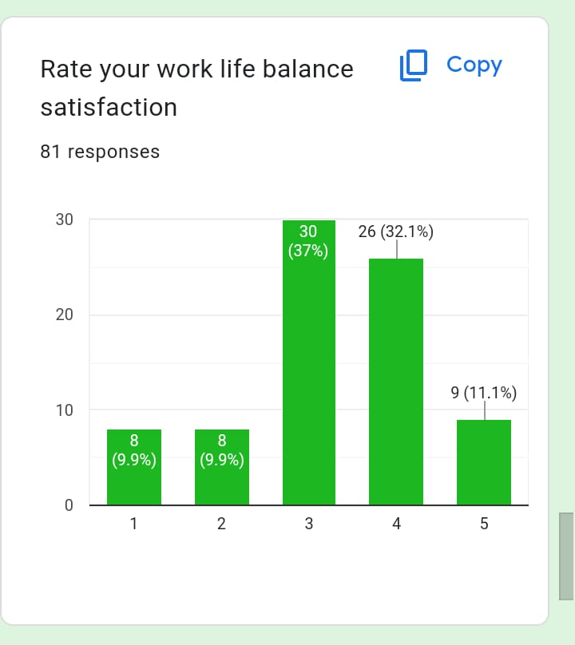
Question 11

Slide 39
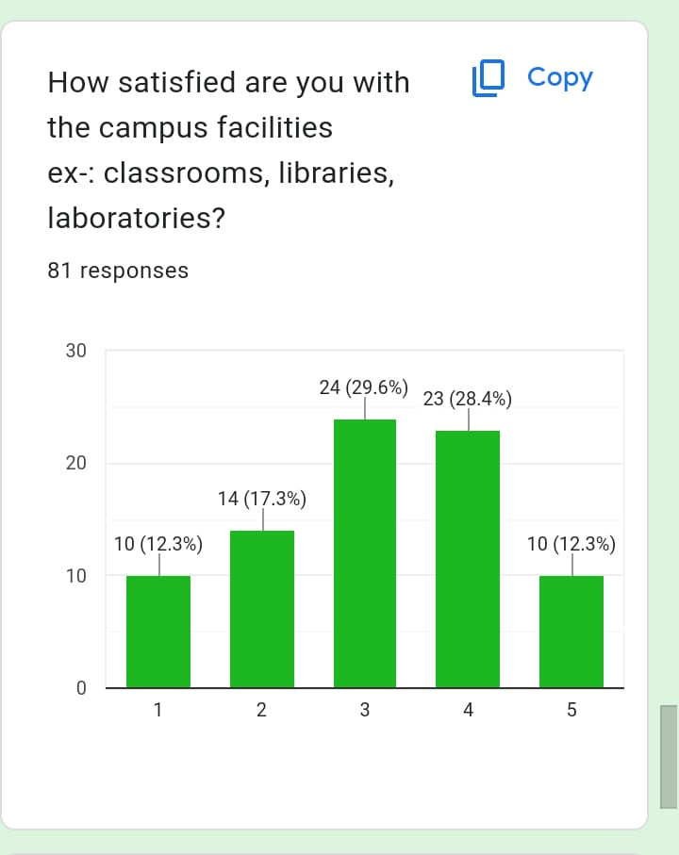
Question 12

Slide 40
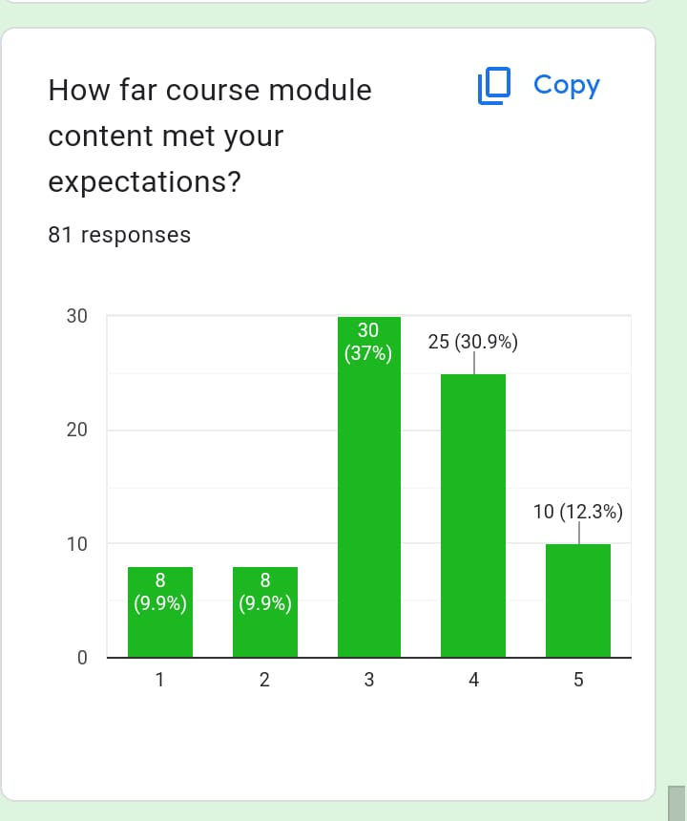
Question 13

Slide 41
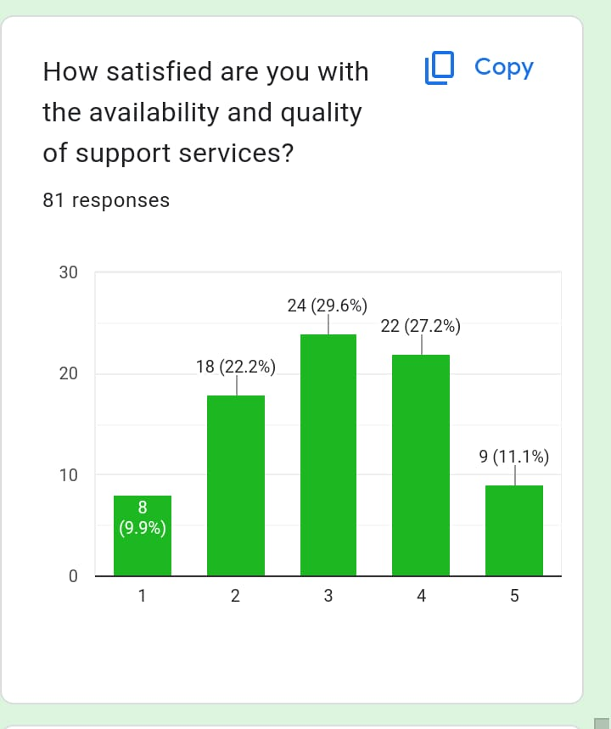
Question 14

Slide 42
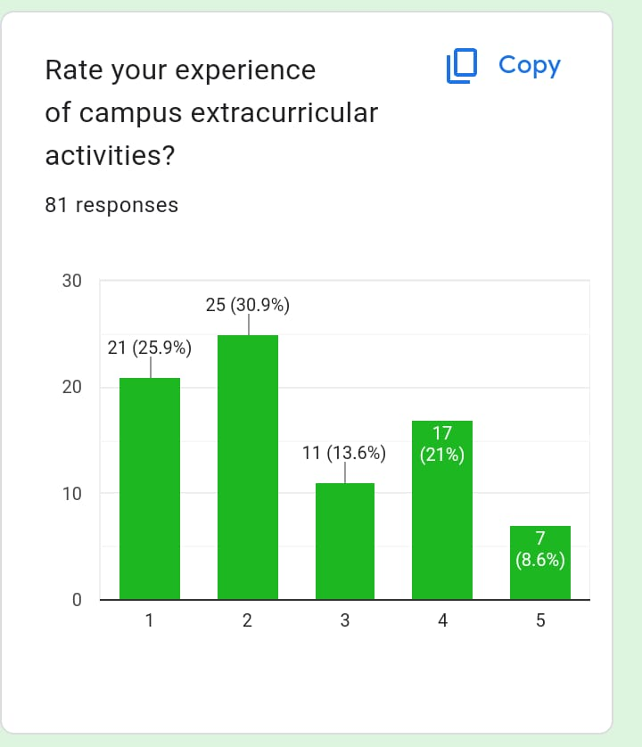
Question 15

Slide 43
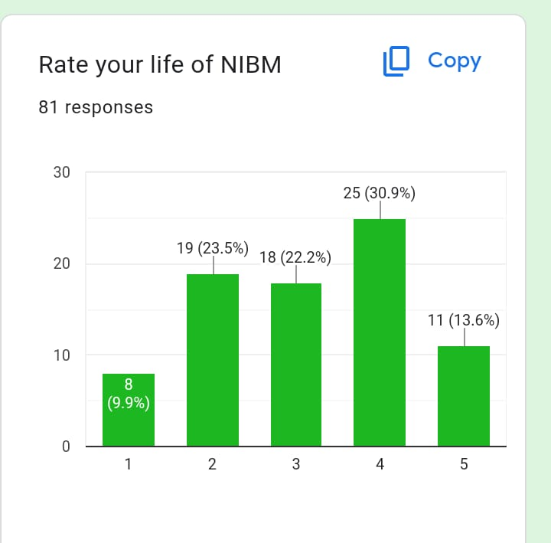
Question 16

Slide 44
Statistical tools to be used in the analysis
Descriptive statistics.
Correlation
regression
Probability
Permutations + Probability
Normal distribution

Slide 45
To represent the data
Google forms
Power BI

Slide 46
GPA vs Student’s satisfaction
Correlation
Regression

Slide 47
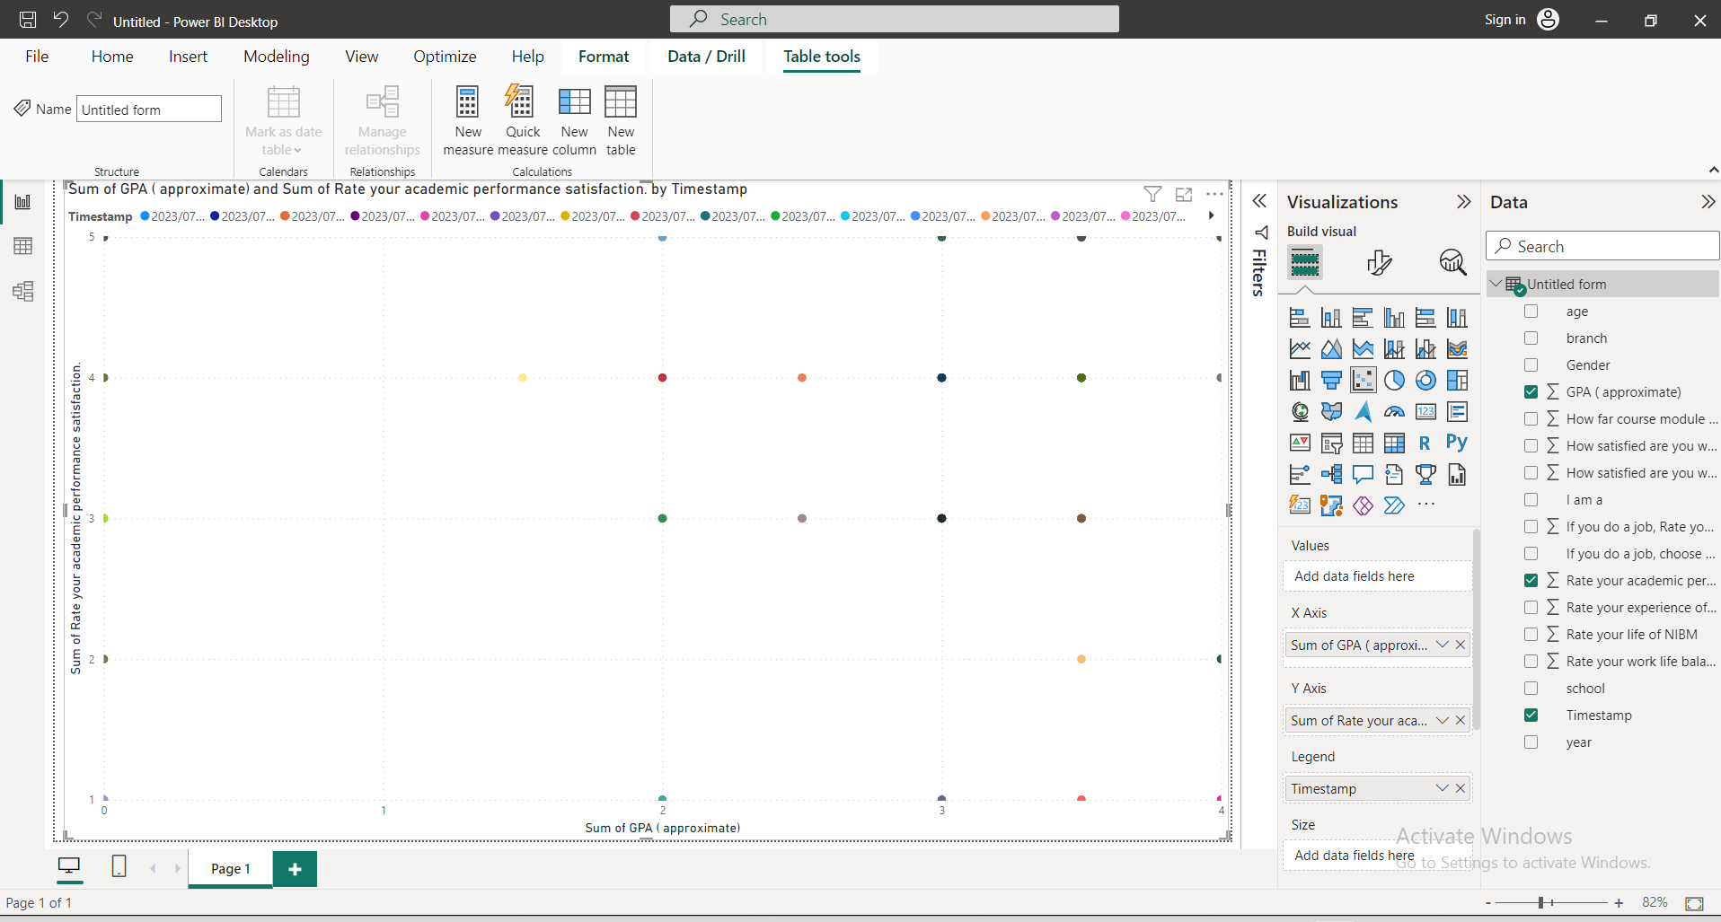
Could not find any patterns
https://drive.google.com/file/d/1V8BJTDkFfGWrV2pmpdxF1TvvULR7SSOO/view?usp=drivesdk
STAT CW
KAHDSE222F-020
LHM fernando

Slide 48
In case of Could not find any correlation & regression patterns,
Could not apply for others
STAT CW
KAHDSE222F-020
LHM fernando

Slide 49
Normal distribution

Slide 50
almost fit with
Normal distribution
STAT CW
KAHDSE222F-020
LHM fernando

Slide 51
almost fit with
Normal distribution
STAT CW
KAHDSE222F-020
LHM fernando

Slide 52
fit with
Normal distribution
STAT CW
KAHDSE222F-020
LHM fernando

Slide 53
fit with
Normal distribution
STAT CW
KAHDSE222F-020
LHM fernando

Slide 54
fit with
Normal distribution
STAT CW
KAHDSE222F-020
LHM fernando

Slide 55
almost fit with
Normal distribution
STAT CW
KAHDSE222F-020
LHM fernando

Slide 56
Not fit with Normal distribution

Slide 57
Could not find any patterns
STAT CW
KAHDSE222F-020
LHM fernando

Slide 58
Could not find any patterns
STAT CW
KAHDSE222F-020
LHM fernando

Slide 59
Probability

Slide 60
STAT CW
KAHDSE222F-020
LHM fernando

Slide 61
Probability of a student is a boy
P(boy) = 0.654
Probability of a student is a girl
P(girl) = 0.320
STAT CW
KAHDSE222F-020
LHM fernando

Slide 62
Permutations +Probability

Slide 63
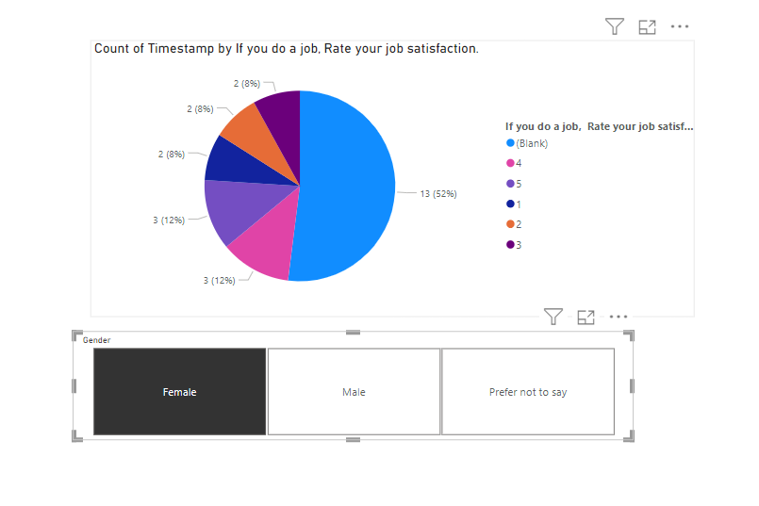
STAT CW
KAHDSE222F-020
LHM fernando

Slide 64
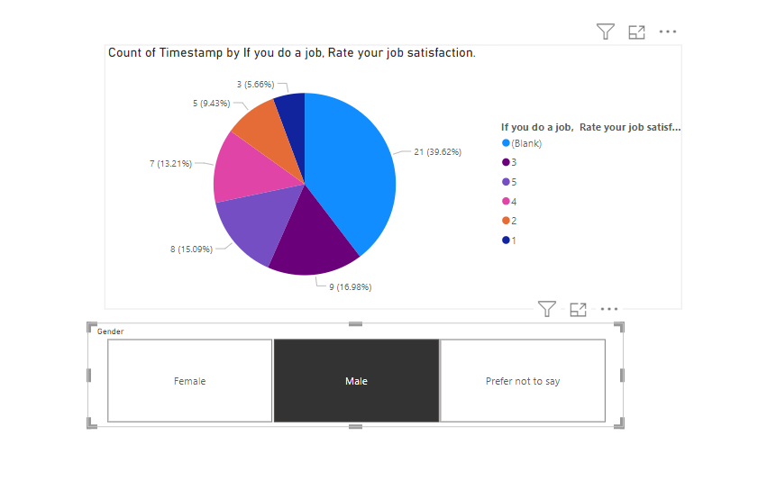
STAT CW
KAHDSE222F-020
LHM fernando

Slide 65
p(boy who do a job) =0.89
p(boy who did not do a job) = 0.21
p(girl who do a job) = 0.48
p(girl who did not do a job) = 0.52
STAT CW
KAHDSE222F-020
LHM fernando

Slide 66
Probability of a student is a boy and do a job
P(boy)*p(boy who do a job) = 0.654*0.89=0.582
STAT CW
KAHDSE222F-020
LHM fernando

Slide 67
Descriptive statistics.

Slide 68
STAT CW
KAHDSE222F-020
LHM fernando

Slide 69
Mean satisfaction
X bar=3.12
Average level
STAT CW
KAHDSE222F-020
LHM fernando

Slide 70
Innovations

Slide 71
low satisfaction for extracurricular activities

Slide 72
Not fit with normal distribution
Student have low satisfaction
with extracurricular activities
STAT CW
KAHDSE222F-020
LHM fernando

Slide 73
low amount of females

Slide 74
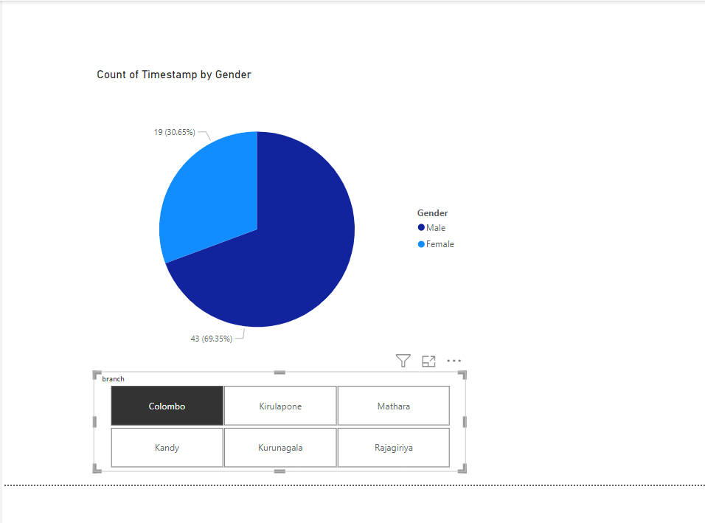
Power bi
https://drive.google.com/file/d/1VCspxYlABGd2b7G0r1_9LViXgL-AqBU4/view?usp=drivesdk
Low amount of females
STAT CW
KAHDSE222F-020
LHM fernando

Slide 75
Branch wise
in case of lack of data
might be wrong predictions

Slide 76
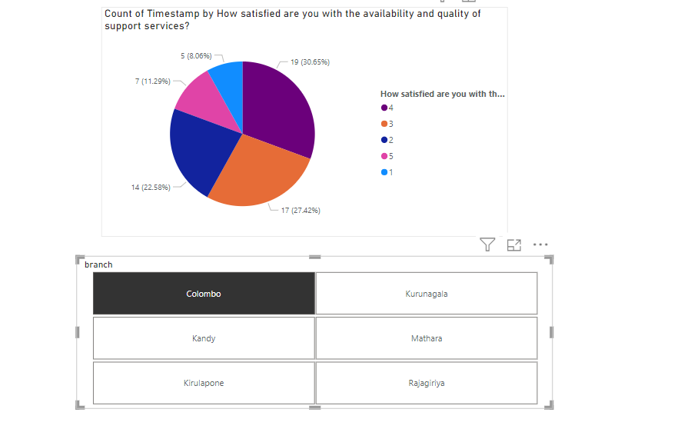
https://drive.google.com/file/d/1VIigx6t4PmKOTtJX43dYP4d8py8PUrso/view?usp=drivesdk
STAT CW
KAHDSE222F-020
LHM fernando

Slide 77
Innovations and key selling points
Longitudinal analysis: If possible, I hope to consider conducting longitudinal analysis by periodically collecting data over a specific timeframe to track changes in satisfaction levels or identify trends in perceptions.
Heatmap visualization: I hope to use heatmap visualization techniques to present the overall satisfaction levels across different aspects of the campus, providing a visually appealing and informative summary of the findings.
Stakeholder engagement: I hope to engage key stakeholders, such as campus administrators or student organizations, in the analysis and decision-making process to ensure the findings are considered and implemented effectively.
STAT CW
KAHDSE222F-020
LHM fernando

Slide 78
How to digitalize for a larger population
To reach a larger population and digitalize data collection, I hope to develop an online survey using platforms like Google Forms or SurveyMonkey. share the survey link through various channels, such as email, social media groups, or campus websites, to reach current students, past students, and other relevant individuals
Used classes to collect the data & do calculations

Slide 79
Thank you
STAT CW
L H M Fernanado
KAHDSE222F-020

